Slide 1
Seaside ABM Overview
Dylan R. Sanderson

Slide 2
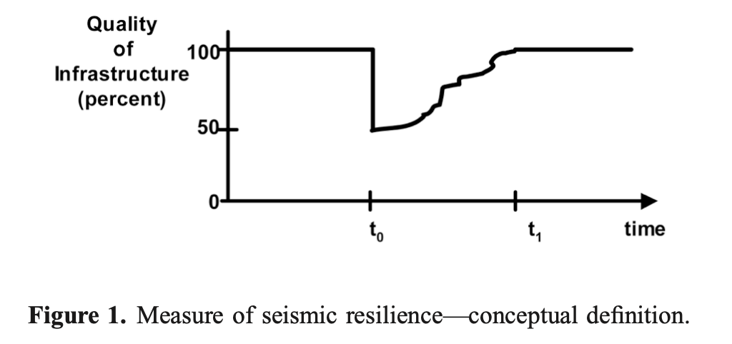
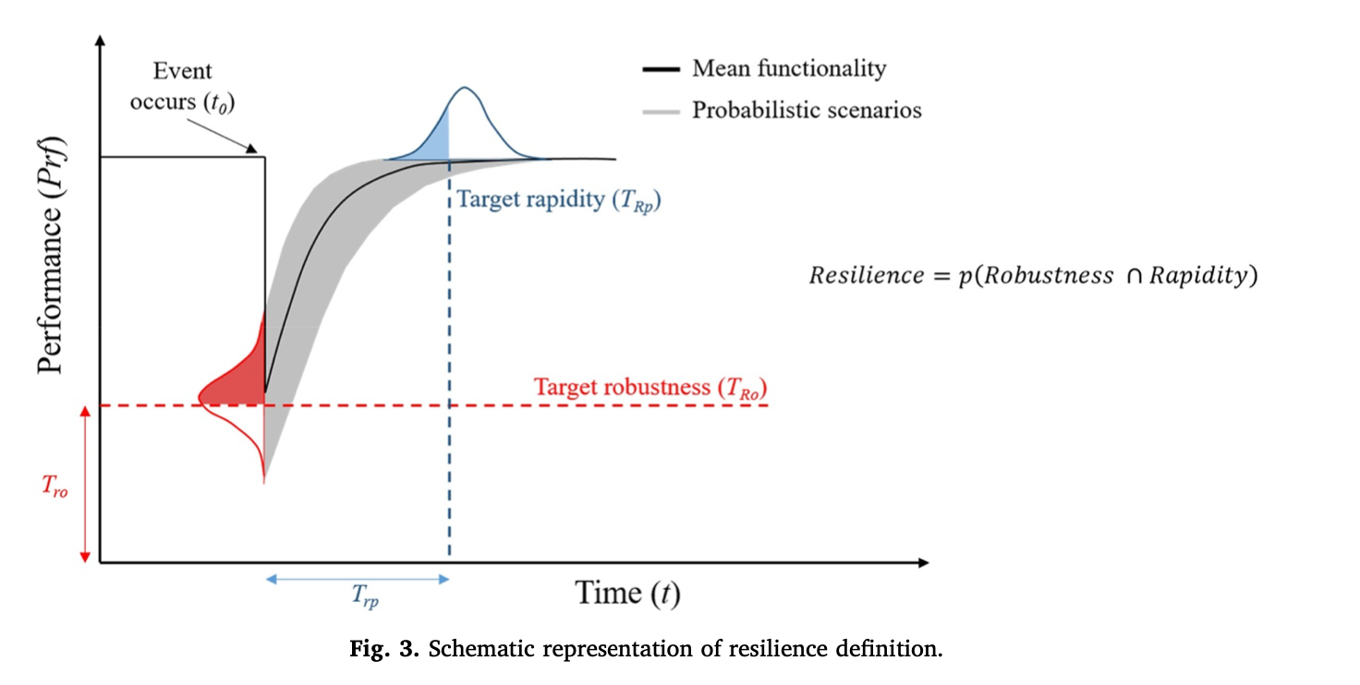
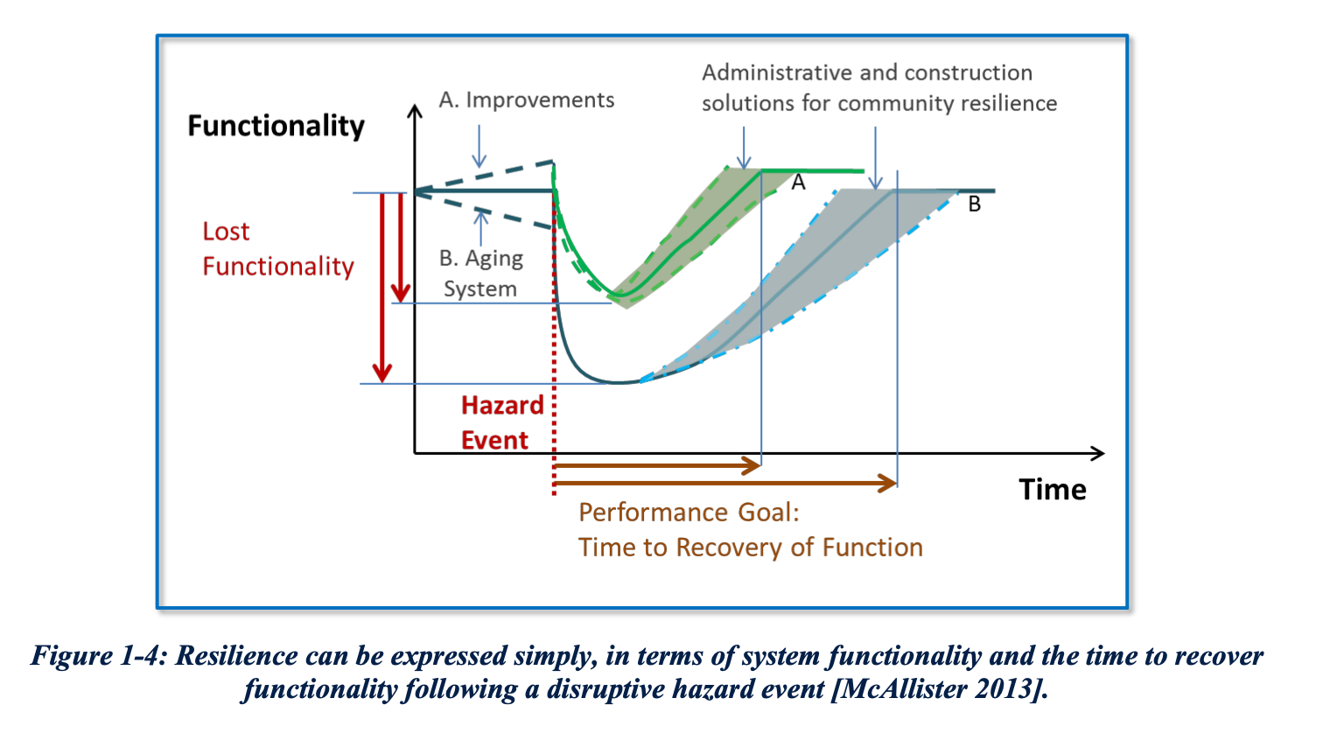
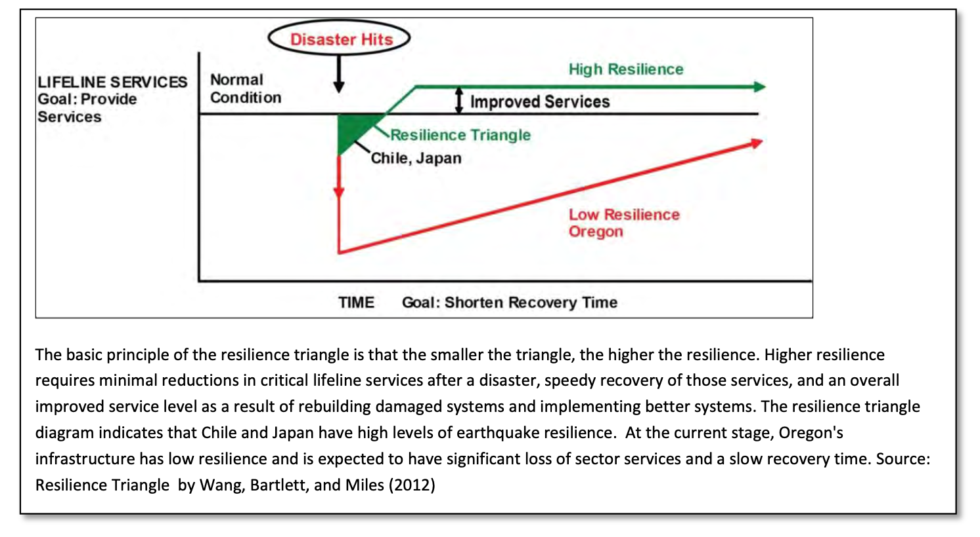
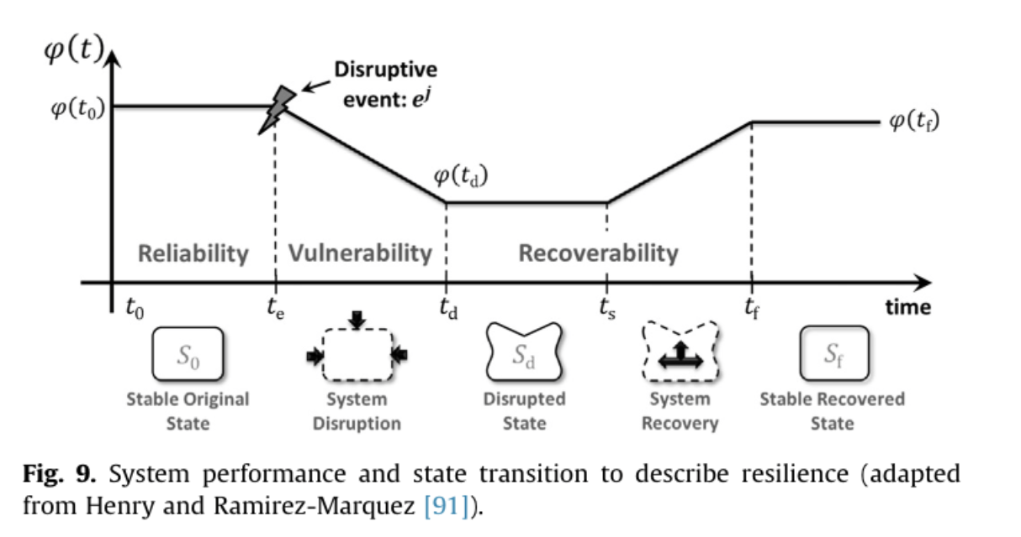
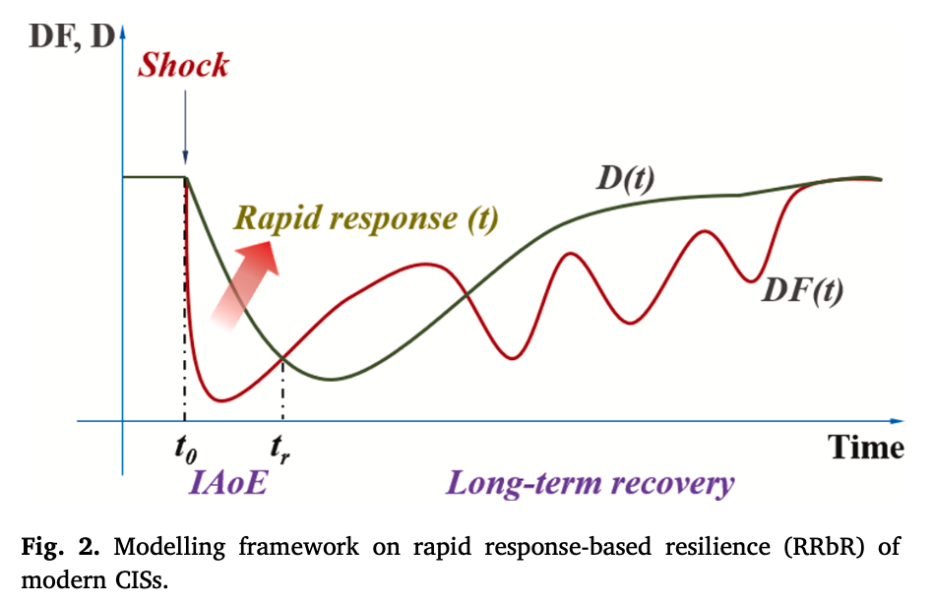
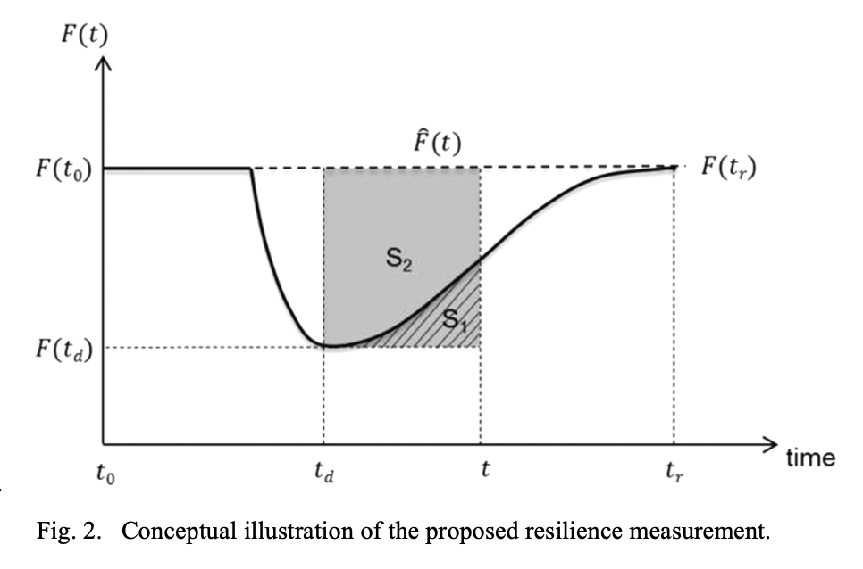
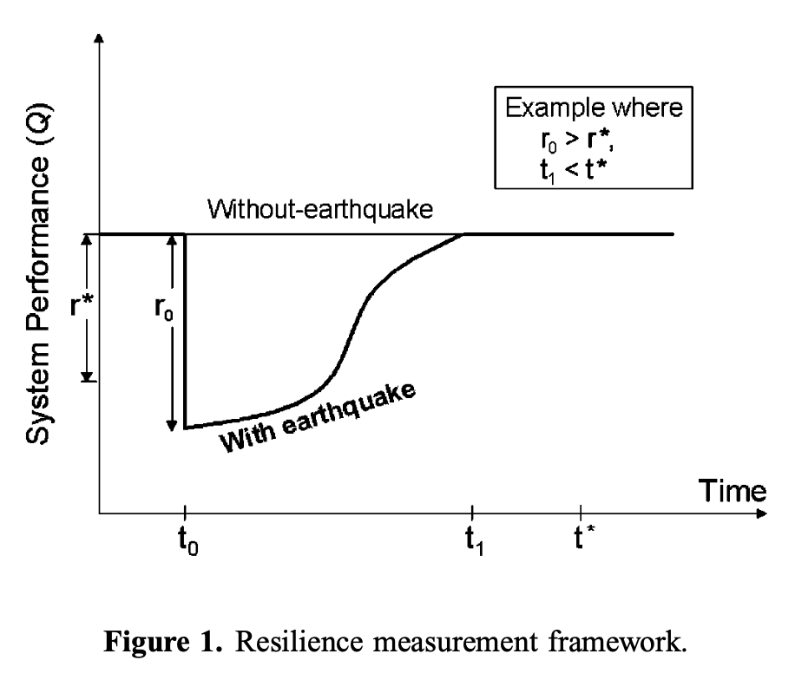
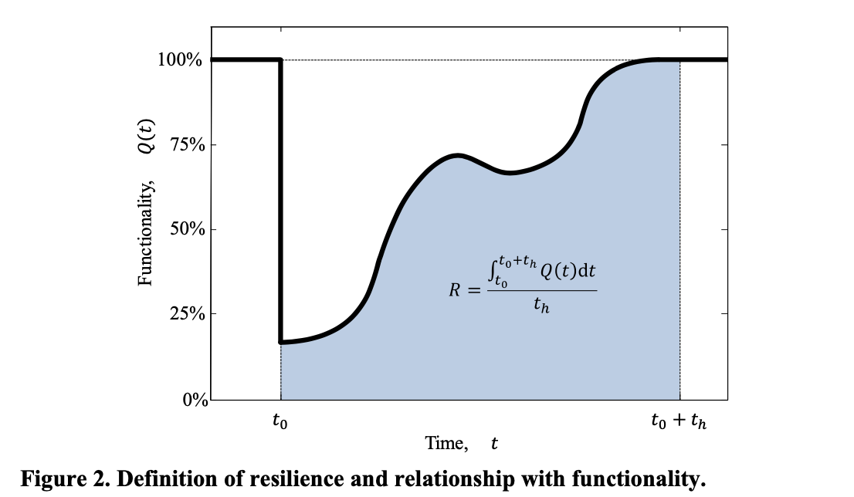
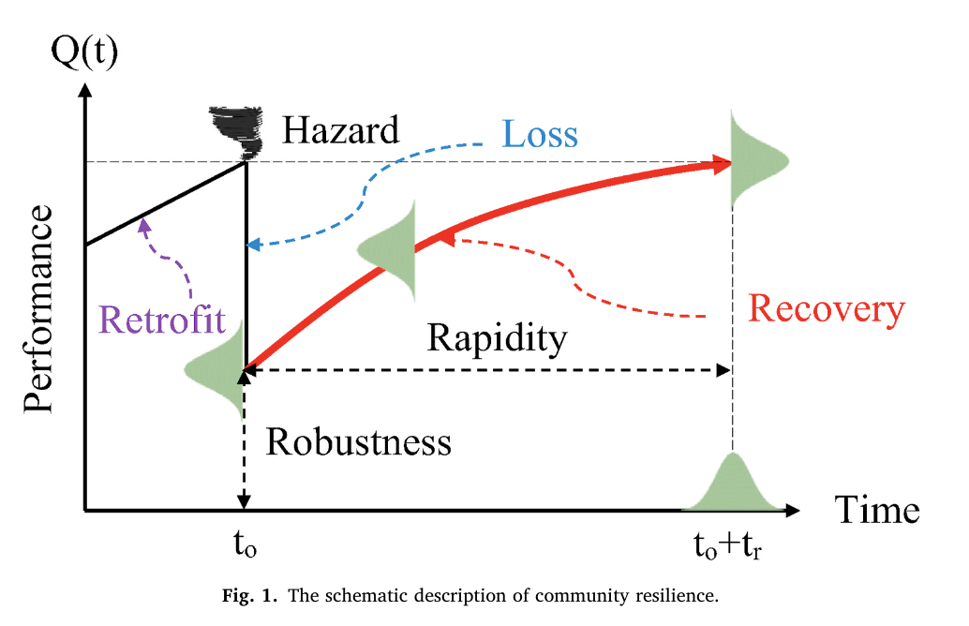
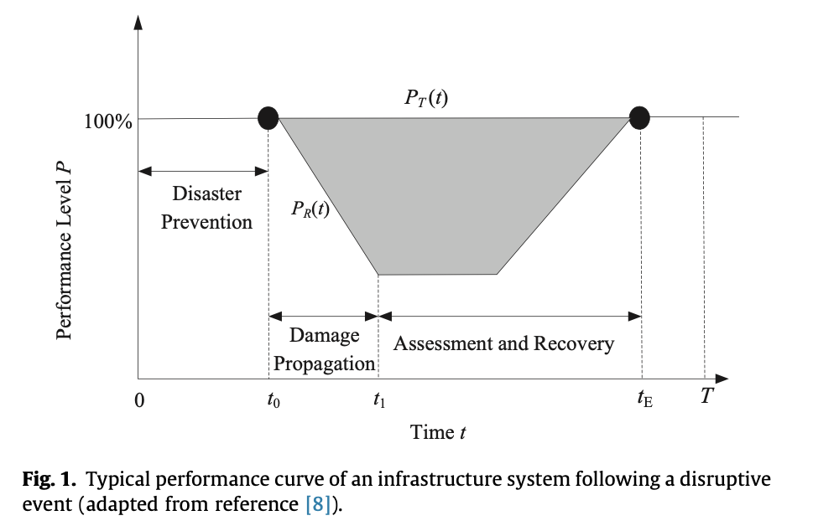
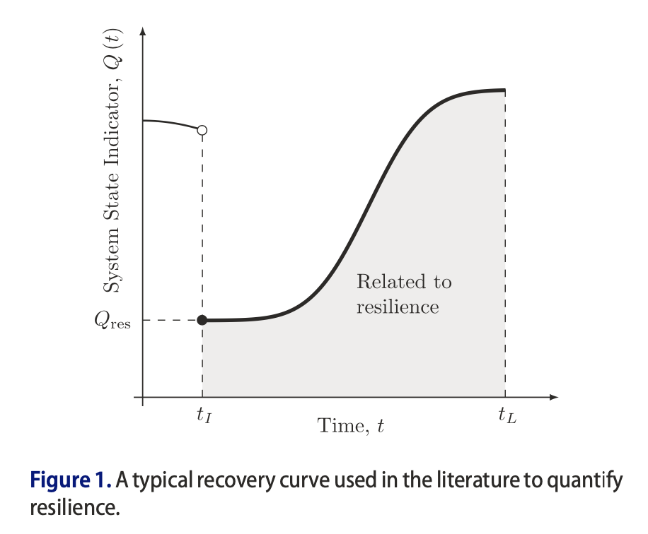
Motivation
Resilience often defined as two parts*:
Loss of system performance
Time to recover
Resilience often evaluated under present-day conditions
Some studies consider infrastructure deterioration
Want to consider what leads to resilient communities
What-if policy B was implemented rather than policy A?
Projections in future; use as a planning tool
Policy, land use planning, and changes to public infrastructure
Bruneau et al. (2003)
Kameshwar et al. (2019)
Some examples of resilience curves
NIST CRPG (2016)
Oregon Resilience Plan (2013)
Disturbance Occurs
Hosseini et al. (2016)
Sun et al. (2021)
Time to recover (repair time)
Fang et al. (2016)
Chang and Shinozuka (2004)
Loss of System Performance (functionality)
System Performance
Frangopol and Bocchini (2011)
Wang and van de Lindt (2021)
Time
*There are nuances in the definition of resilience. Some definitions have more than two parts (e.g., UNDRR Terminology on Disaster Risk Reduction)
Ouyang and Dueñas-Osorio (2014)
Sharma et al. (2018)

Slide 3

Motivation
Incentive individual behavior
Retrofit public infrastructure
Public education initiatives
Land use planning
City zoning regulations
Establish building codes
Relocate public infrastructure
Property Buyouts/Land Acquisition
Developing model with two parts:
Urban land use evolution model used to evaluate how different policy choices can lead to community changes over decades
IN-CORE is used to evaluate the damage & loss and risk avoidance after a given amount of time
Considering mitigation options on scale from household decisions to state & federal decisions
No regulations
Household Decisions
Authority Having Jurisdiction
(AHJ)
State & Federal Decisions
Disturbance Occurs
Policy A
Urban land use evolution model
Status quo
Metric of interest
0 10 20 30 40
Present Day
Time (years)

Slide 4


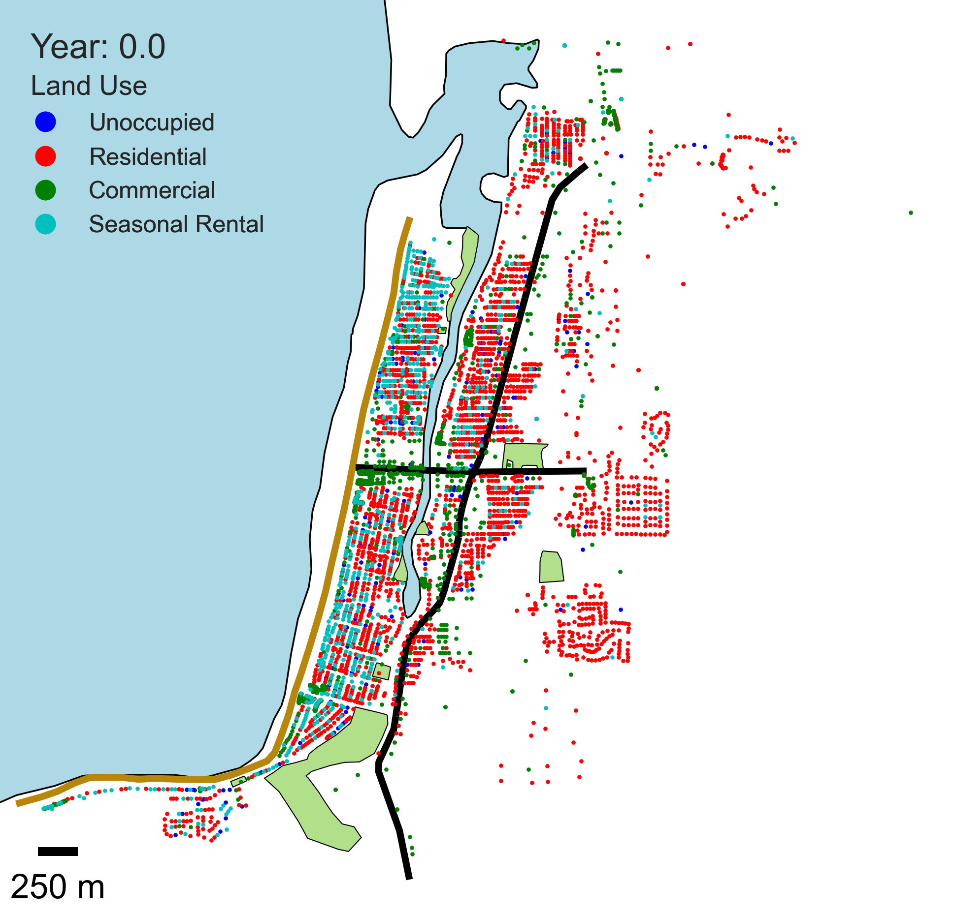
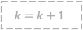
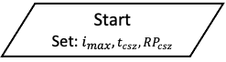

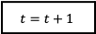
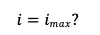



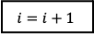
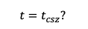

Approach
8b) Suite of policy levers and decision combinations
Property buyouts/Land Acquisition
Relocate public infrastructure
Retrofit public infrastructure
Establish building codes
City zoning regulations
Land use planning
Incentivize individual behavior (?)
Public education initiatives (?)
No regulations
Start
Set:$i_{max}, t_{csz}, RP_{csz}$
$$t=0$$
8c) Economic, social, and physical infrastructure constraints
STOP – Adjust community goals/constraints
5a) Community Goals Based on Stability Metrics
Agent-based model for urban landscape evolution
8a) Optimization to select next PD for analysis from suite of n combinations
No
Yes
7a) Optimization Still Possible?
No
6a) Sufficient Quality Solutions Found?
Yes
No
Urban landscape at time t
END
$$i=imax?$$
$$k=k+1$$
Yes
Time $j=j+1$
No
$j=m$?
Yes
2b) Damage Models
3a) Functionality Models
1) Current Community Description at time t
1a) Built Environment
1b) Social Systems
1c) Economic Systems
Record Quality Solutions
$$i=i+1$$
$$t=t_{csz}?$$
Yes
2c) Damage to physical Infrastructure
3b) Functionality of physical Infrastructure
4a) State of Recovery for community at time=$j$
No
2a) Hazard Models
3c) CGE Model
3d) Population Dislocation Model
END - Visualization
2d) Casualty
3e) Direct and Indirect Economic & Social Losses
Analysis $K$ complete
$$t=t+1$$

Slide 5
Parcel Land Use Hierarchy
Land use types:
Unoccupied
Owned Residential
Rental Residential
Low occupancy seasonal rentals
Commercial
High occupancy residential
High occupancy seasonal rentals
Owner
Driven by tourist population
Unoccupied
Driven by permanent population
Static – does not evolve
Individual
Landlord
Owned Residential
Rental Residential
Long-term rental
Low occupancy seasonal rental
Short-term rental (Airbnb)
Developer
High occupancy residential
High occupancy seasonal rental
Commercial

Slide 6
Agent-Driven Market
Driven by tourist population
Unoccupied
Driven by permanent population
Static – does not evolve
Individuals
Associated with Owned Residential land use
Decisions:
No change
Purchase unoccupied property
Purchase property from landlord
Purchase agreement with landlord (L5)
Sell property to landlord
Selling agreement with landlord (L4)
Sell property to developer
Selling agreement with developer (D4)
Individual
Landlord
Owned Residential
Rental Residential
Long-term rental
Low occupancy seasonal rental (LOSR)
Short-term rental (Airbnb)
Interaction with self
Interaction with landlord
Developer
High occupancy residential (HOR)
Commercial
High occupancy seasonal rental (HOSR)
Interaction with developer
Landlords
Associated with Rental Residential and LOSR
Decisions:
No change
Transition parcel between Rental Residential and LOSR
Driven by resident/tourist numbers
Purchase unoccupied property
Purchase property from individual
Purchase agreement with individual (I4)
Sell property to individual
Selling agreement with individual (I3)
Sell property to developer
Selling agreement with developer (D5)
Developers
Associated with HOR, Commercial, and HOSR
Decisions:
No change
Transition parcel from commercial to HOSR
Driven by resident/tourist numbers
Purchase unoccupied property
Purchase property from individual
Purchase agreement with individual (I5)
Purchase property from landlord
Purchase agreement with landlord (L6)
Look into Cobb-Douglas utility functions!!
Interaction with self
Interaction with self
Interaction with individual
Interaction with individual
Interaction with landlord
Interaction with developer

Slide 8
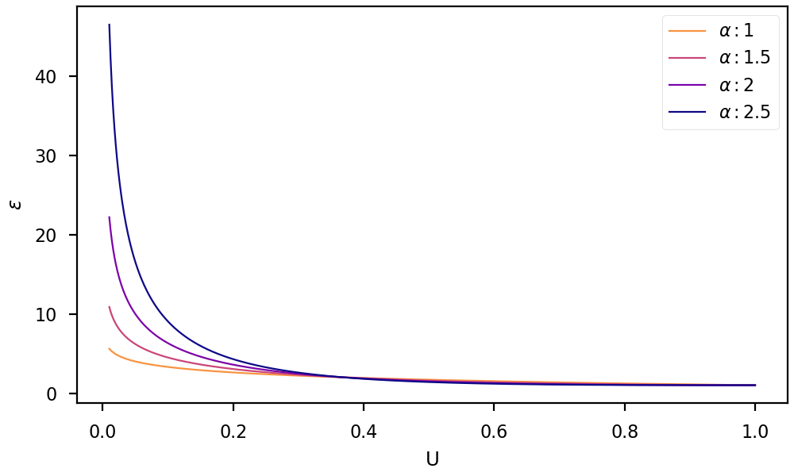
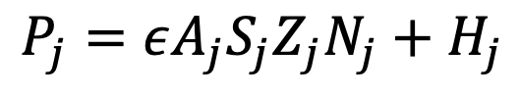
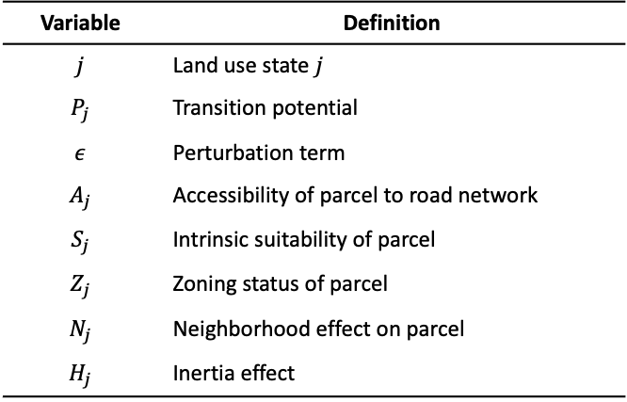

ABM and Transition Potential
$$ε=1+{\left(−\ln{U}\right)}^{α}$$
ABM Rules:
Four land use types unoccupied (U), residential (R), commercial (C), and seasonal rental (SR)
Number of cells that transition is set as input for first iteration; next iterations by growth rate
Neighborhood is radius of 50 meters; distance weighting function
Transition potential from White and Engelen (2000)
Cells that transition are the number of transitioning cells for iteration (rule 2) with highest potential (rule 4)
Using transition potential from White and Engelen (2000)
Highly cited: 857 citations on Google Scholar
Used by Hemmati et al. (2021)
Variable | Definition
$$j$$ | Land use state $j$
$$P_{j}$$ | Transition potential
$$ε$$ | Perturbation term
$$A_{j}$$ | Accessibility of parcel to road network
$$S_{j}$$ | Intrinsic suitability of parcel
$$Z_{j}$$ | Zoning status of parcel
$$N_{j}$$ | Neighborhood effect on parcel
$$H_{j}$$ | Inertia effect
$$P_{j}=εA_{j}S_{j}Z_{j}N_{j}+H_{j}$$
Incentive individual behavior
Retrofit public infrastructure
Public education initiatives
Land use planning
City zoning regulations
Establish building codes
Relocate public infrastructure
Property Buyouts/Land Acquisition
No regulations
Household Decisions
State & Federal Decisions

Slide 9
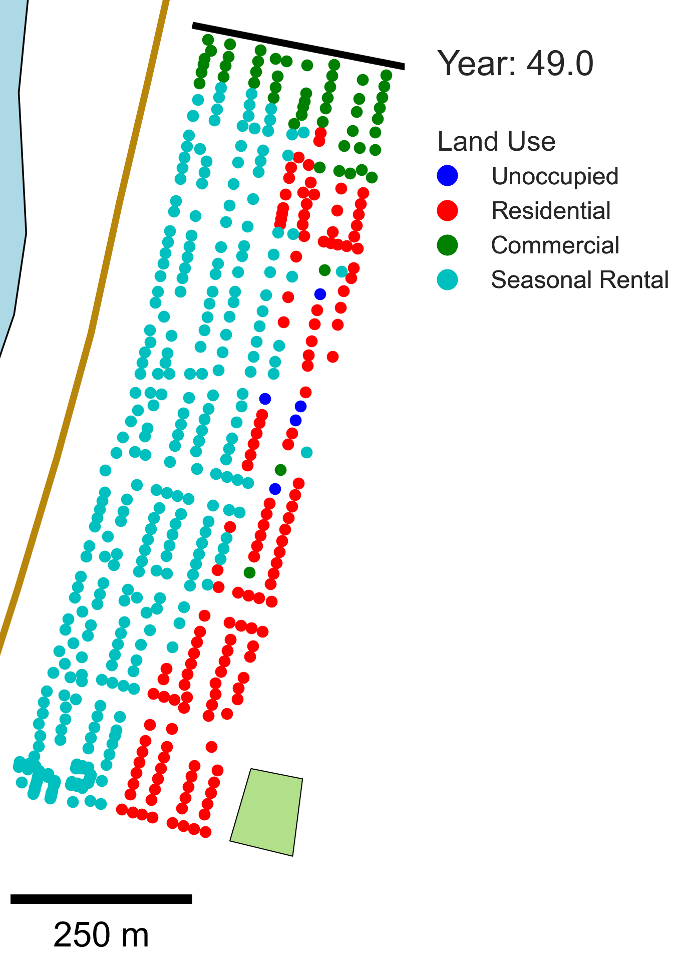
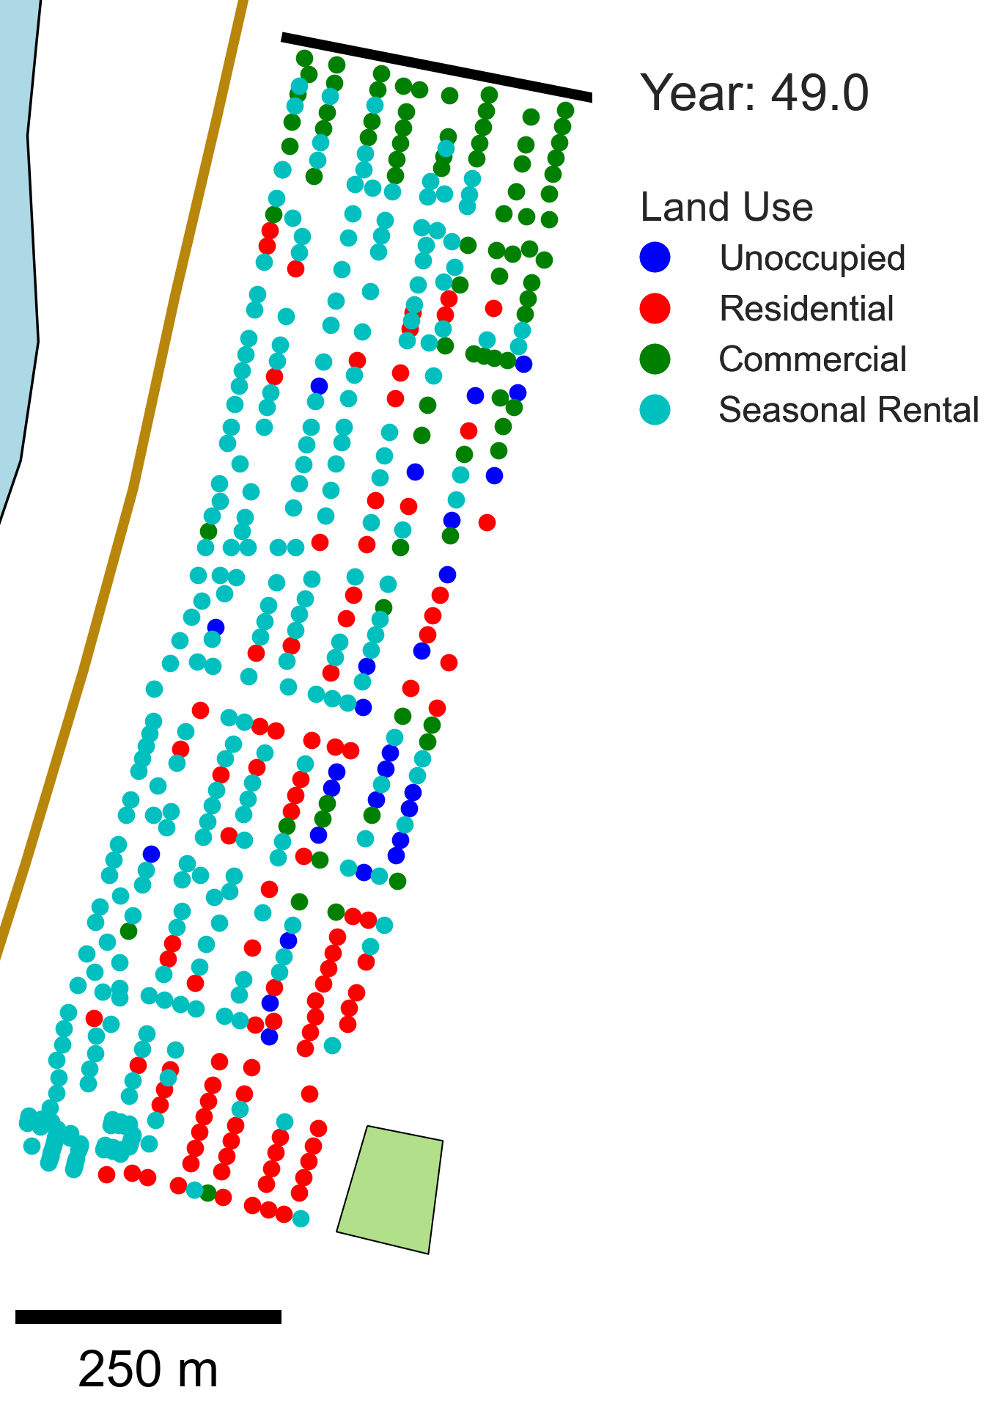
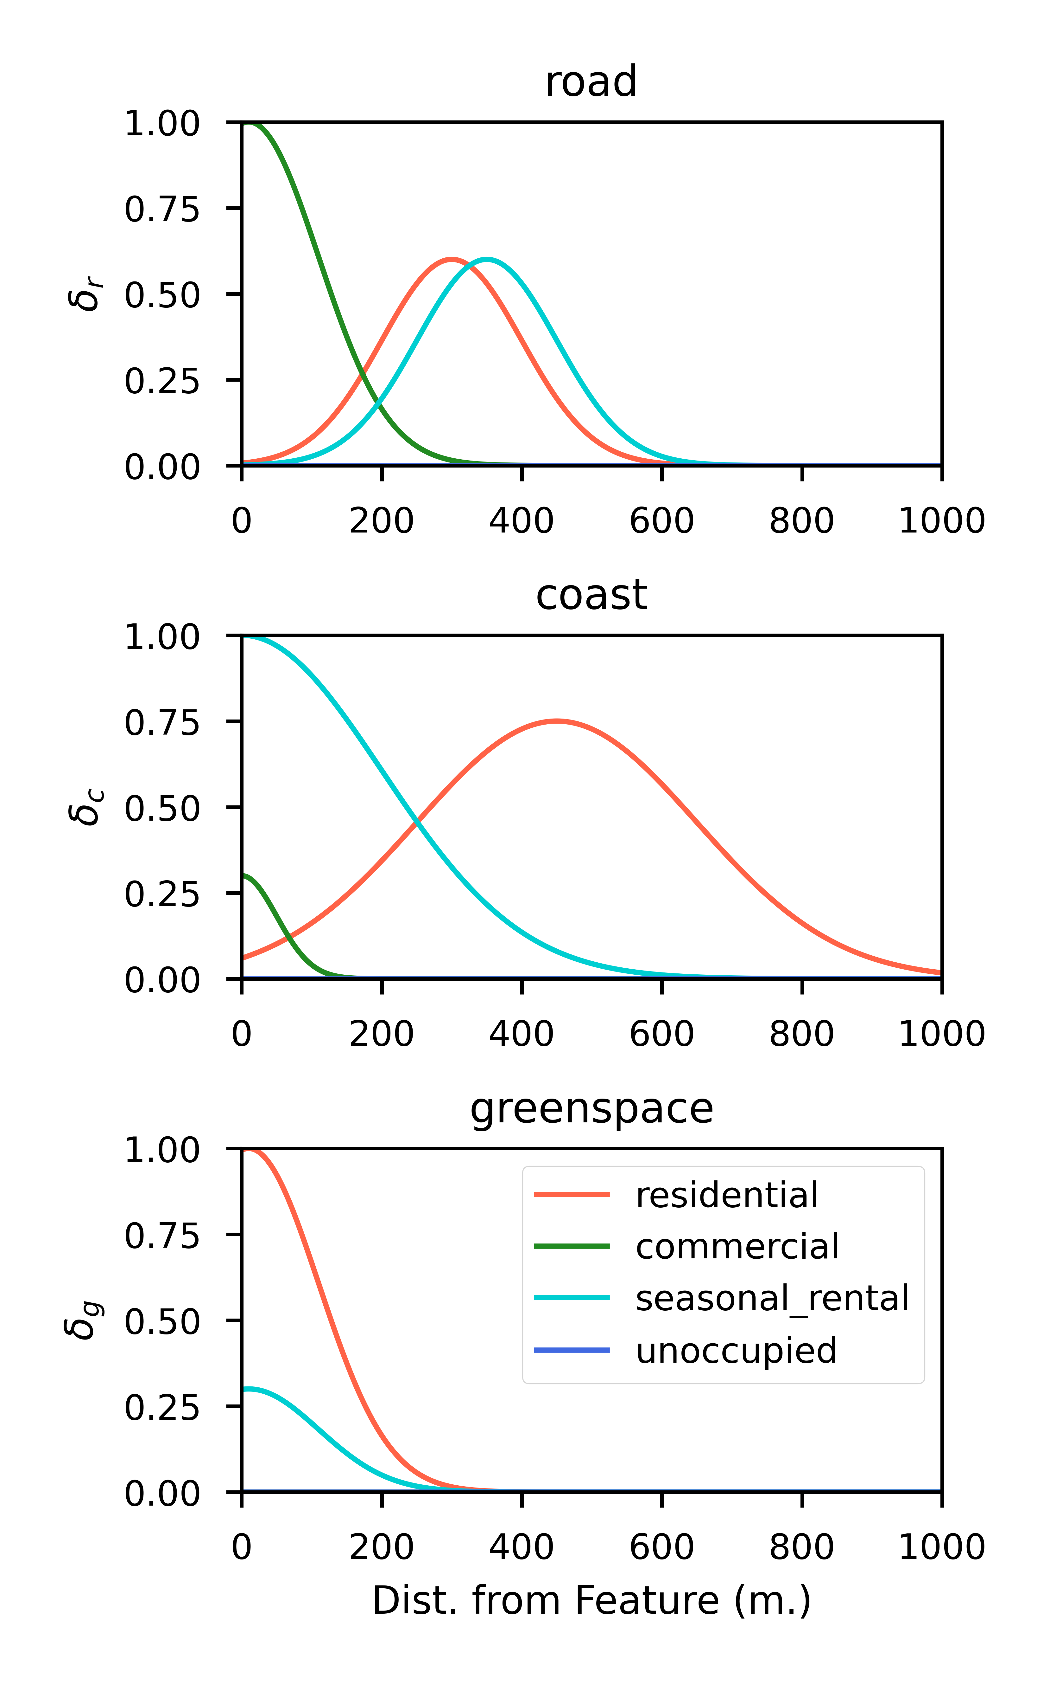
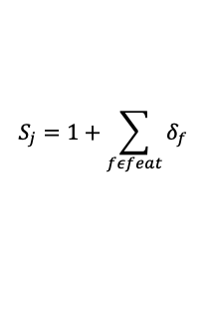
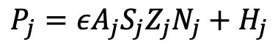
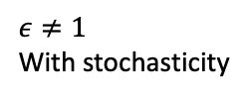
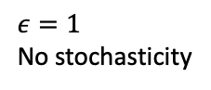
Incentive individual behavior
Retrofit public infrastructure
Planning Tools
Property Buyouts/Land Acquisition
No regulations
Public education initiatives
Land use planning
City zoning regulations
Establish building codes
Relocate public infrastructure
Land use planning = Accessibility and Suitability terms
Can set maximum distance that parcels “feel” a feature
Accessibility = how close is parcel to road network
Consider major roads, rather than all roads
Suitability captures more than accessibility does
Here: considering distance to coast and distance to greenspace.
Hemmati et al. (2021): educational facilities, city center, entertainment centers, greenspaces, water bodies, land price, etc.
Household Decisions
State & Federal Decisions
$$A_{j}={1+δ}_{r}$$
$$ε=1$$
No stochasticity
$$ε≠1$$
With stochasticity
$$S_{j}=1+\sum_{fεfeat}{δ_{f}}$$
$$P_{j}=εA_{j}S_{j}Z_{j}N_{j}+H_{j}$$
Accessibility to major roads
Distance to coast
Distance to greenspace

Slide 10
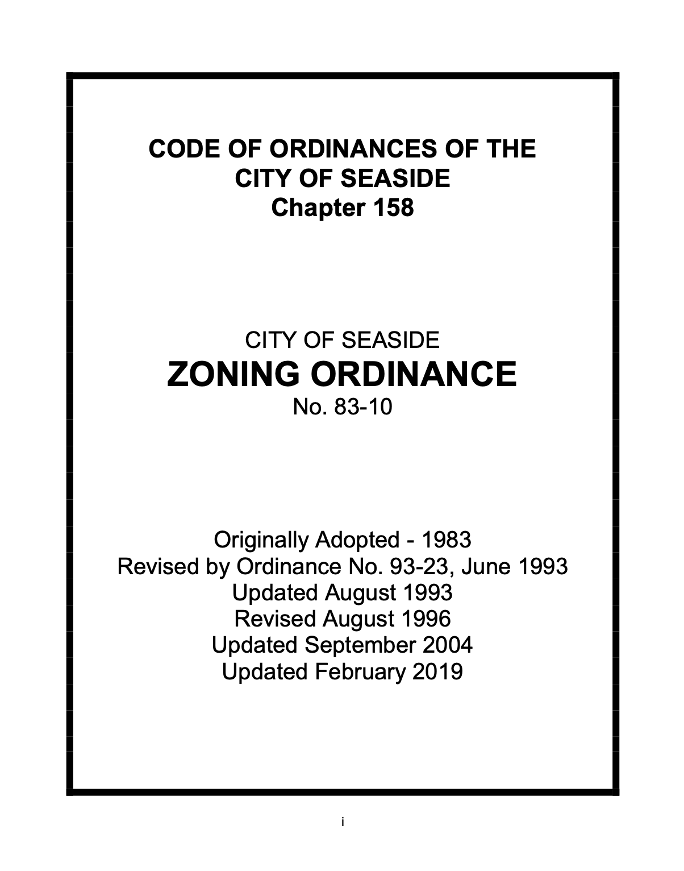
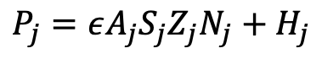
Incentive individual behavior
Retrofit public infrastructure
Planning Tools
Property Buyouts/Land Acquisition
No regulations
Public education initiatives
Land use planning
City zoning regulations
Establish building codes
Relocate public infrastructure
$$P_{j}=εA_{j}S_{j}Z_{j}N_{j}+H_{j}$$
Household Decisions
State & Federal Decisions
Zone | Description
Agricultural Forest | No description
Airport Development | Provides lands for airport facilities
Aquatic Conservation | Aquatic areas which can withstand limited amounts of adjacent development or alteration
Aquatic Natural | Aquatic areas which should be managed for resource protection, preservation, and restoration
Central Commercial | Provide for a broad range of commercial and business activities that meet day-to-day needs of communities' permanent residents
Exclusive Farm Use | Provide areas for continued practice of agriculture
Freshwater Wetlands | Assure conservation of important shoreland and wetland biological habitats
General Commercial | Provide more intensive commercial uses which do not require prime areas such as in CBD or resort areas. Wholesale or other uses in fringe area of CBD.
High Density Residential | Provide for high-density multi-family development; predominantly single-family, but multi-family units are primary new development. Other uses such as rooming and boarding houses, churches, schools, parks, government buildings, condominiums, etc.
Industrial | Provide for limited industrial development
Lake and Wetlands | Assure conservation of important shoreland and wetland biological habitats
Low Density Residential | Provide for low-density single-family development; other uses consistent with residential neighborhoods (schools, churches, community uses, etc.)
Medium Density Residential | Provide for moderately dense housing
Neighborhood Commercial | Location of small businesses and services adjoining residential areas.
Open Space / Parks | Provide for conservation of open space and protection and development of areas suited for outdoor recreation
Residential - Commercial | Mix of residential and commercial.
Residential / Suburban | To allow existing development patterns to continue until municipal sewer facilities are provided.
Residential Agriculture | No description
Resort Commercial | Provide tourist-oriented facilities and services.
Resort-Residential | Provide space for orderly expansion of tourist accommodations and related business such as restaurants and gift shops. Currently single-family units, but are in a state of transition
https://delta.co.clatsop.or.us/apps/ClatsopCounty/index.html

Slide 11
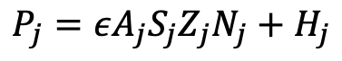
Incentive individual behavior
Retrofit public infrastructure
Planning Tools
Property Buyouts/Land Acquisition
No regulations
Public education initiatives
Land use planning
City zoning regulations
Establish building codes
Relocate public infrastructure
Household Decisions
State & Federal Decisions
Testbed Use | Zone | U | R | C | SR
Open Space | Agricultural Forest | 1 | 0 | 0 | 0
 | Aquatic Conservation
 | Aquatic Natural
 | Exclusive Farm Use
 | Freshwater Wetlands
 | Lake and Wetlands
 | Open Space / Parks
Commercial-Residential | Neighborhood Commercial | 0 | 1 | 1 | 0
 | Residential - Commercial
Commercial-Resort | Resort Commercial | 0 | 0 | 1 | 1
Commercial | Central Commercial | 0 | 0 | 1 | 0
 | General Commercial
Residential | Low Density Residential | 0 | 1 | 0 | 0
 | Residential Agriculture
 | Medium Density Residential
 | Residential Suburban
 | High Density Residential
Residential-Resort | Resort-Residential | 0 | 0.5 | 0 | 1
Not in use | Airport Development | - | - | - | -
 | Industrial
Residential-Resort: Provide space for orderly expansion of tourist accommodations and related business such as restaurants and gift shops. Currently single-family units, but are in a state of transition
$$P_{j}=εA_{j}S_{j}Z_{j}N_{j}+H_{j}$$
Zoning Term

Slide 12
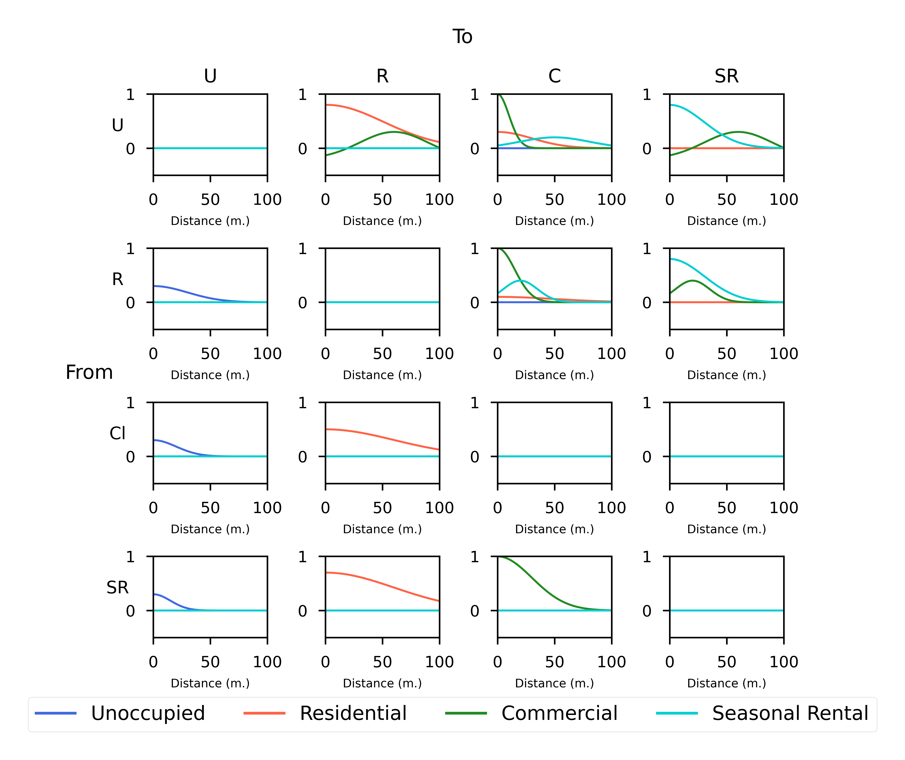
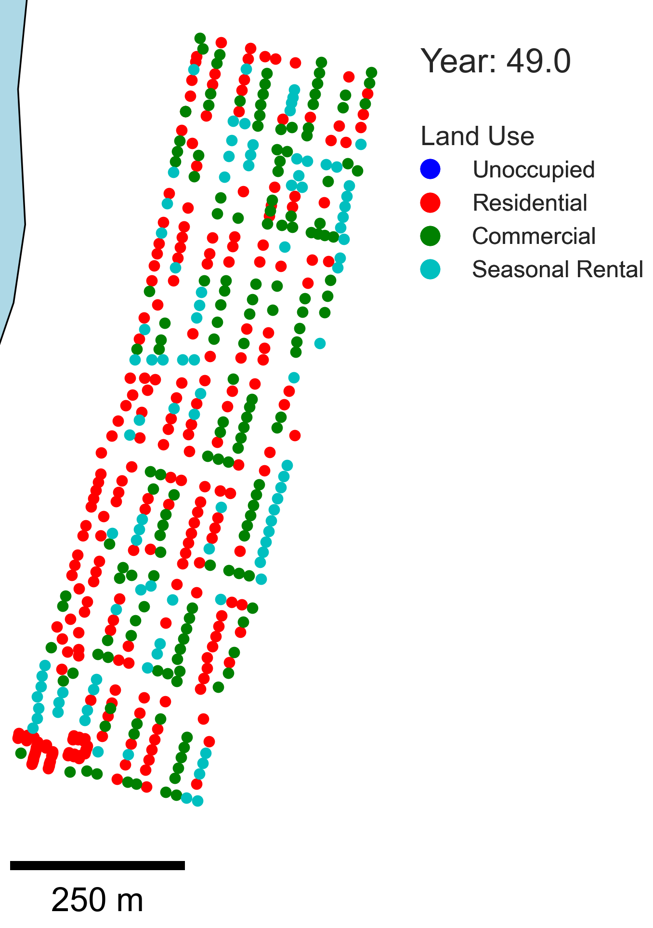
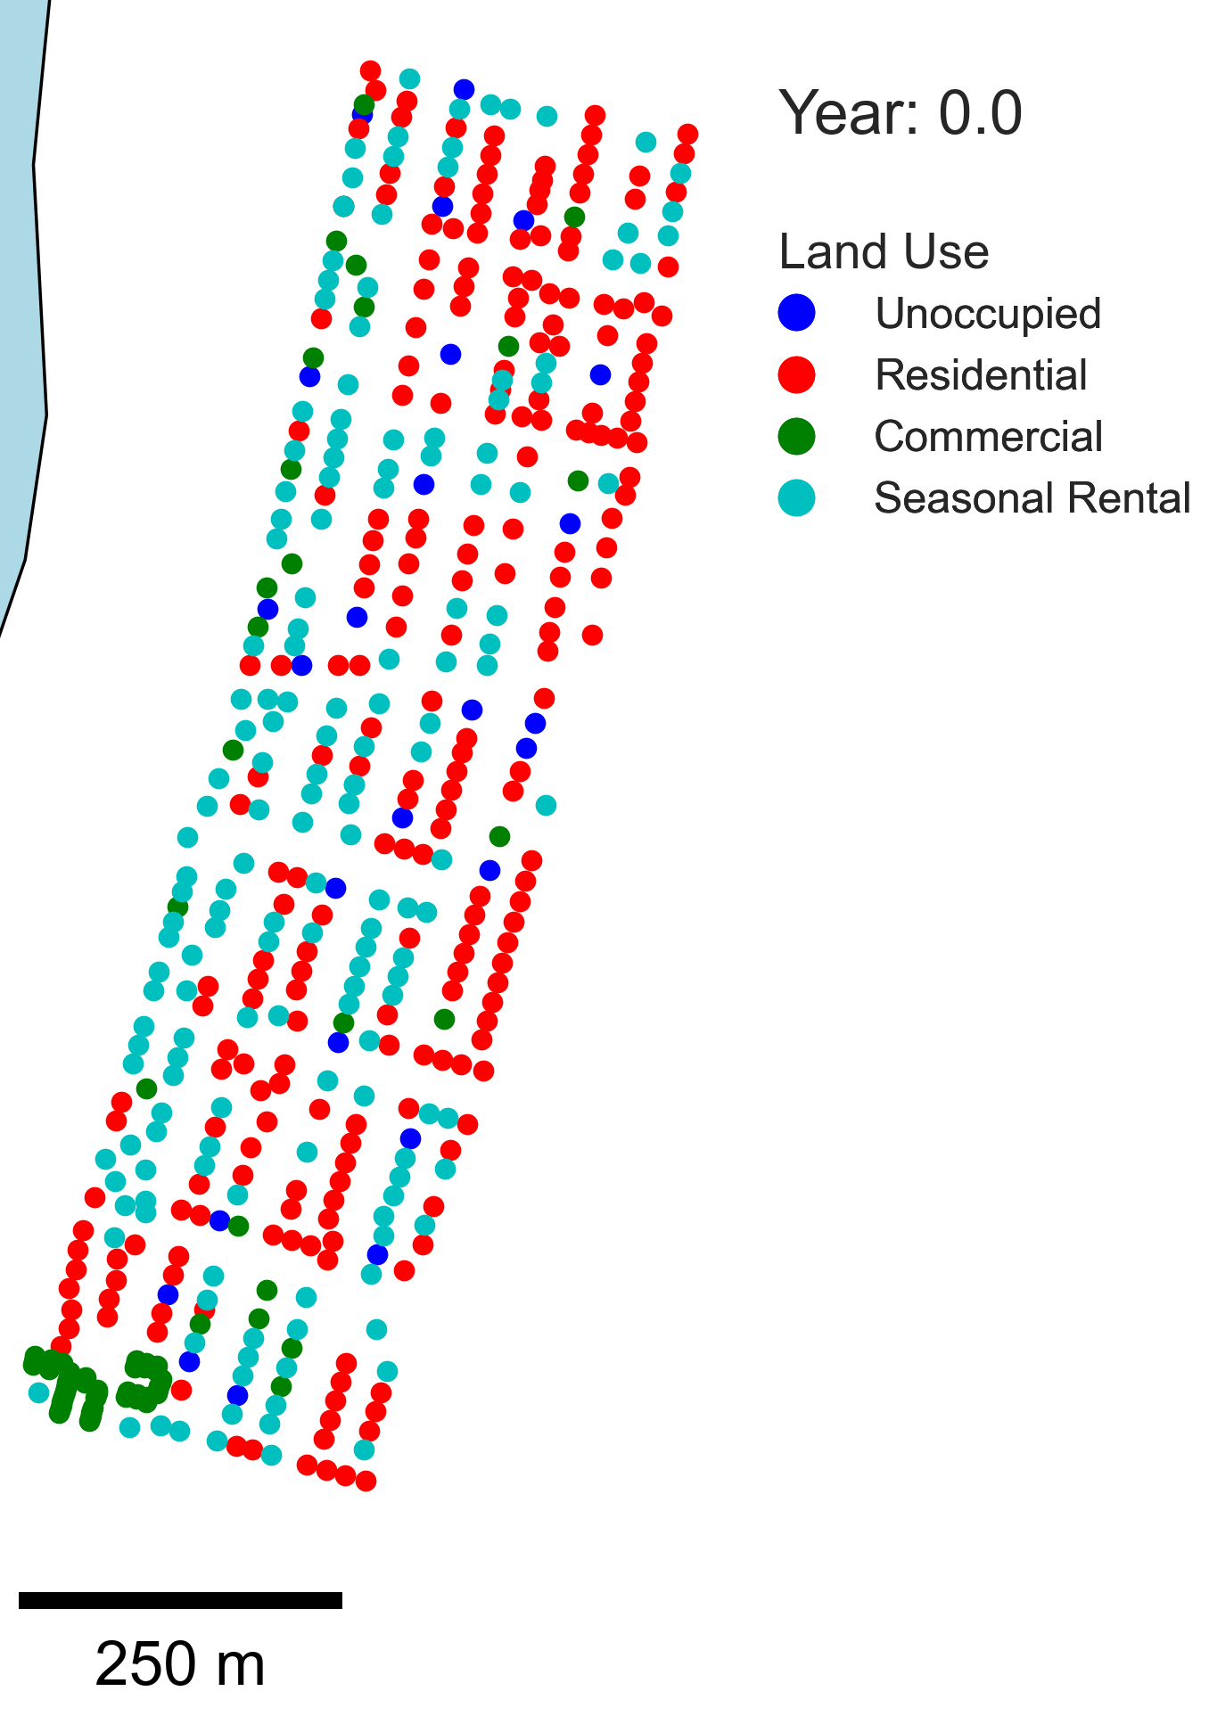
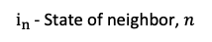
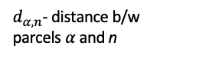

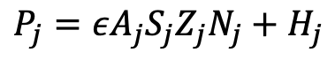
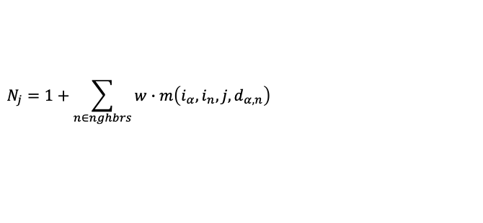
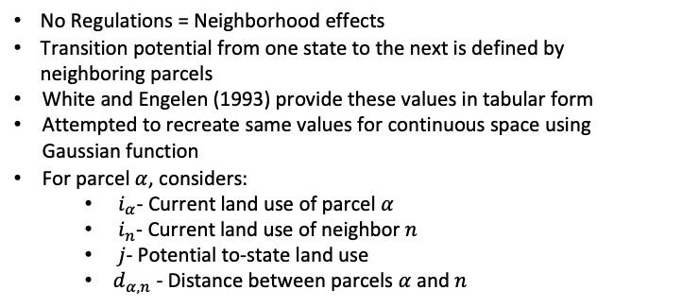
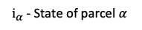
Incentive individual behavior
Retrofit public infrastructure
Planning Tools
Property Buyouts/Land Acquisition
No regulations
Public education initiatives
Land use planning
City zoning regulations
Establish building codes
Relocate public infrastructure
No Regulations = Neighborhood effects
Transition potential from one state to the next is defined by neighboring parcels
White and Engelen (1993) provide these values in tabular form
Attempted to recreate same values for continuous space using Gaussian function
For parcel $α$, considers:
$i_{α}$- Current land use of parcel $α$
$i_{n}$- Current land use of neighbor $n$
$j$- Potential to-state land use
$d_{α,n}$ - Distance between parcels $α$ and $n$
Household Decisions
State & Federal Decisions
$$P_{j}=εA_{j}S_{j}Z_{j}N_{j}+H_{j}$$
$$N_{j}=1+\sum_{n∈nghbrs}{w∙m\left(i_{α}, i_{n}, j, d_{α,n}\right)}$$
$$α$$
$d_{α,n}$- distance b/w parcels $α$ and n
$i_{α}$- State of parcel $α$
n
$i_{n}$- State of neighbor, $n$
Initial Community Description

Slide 13
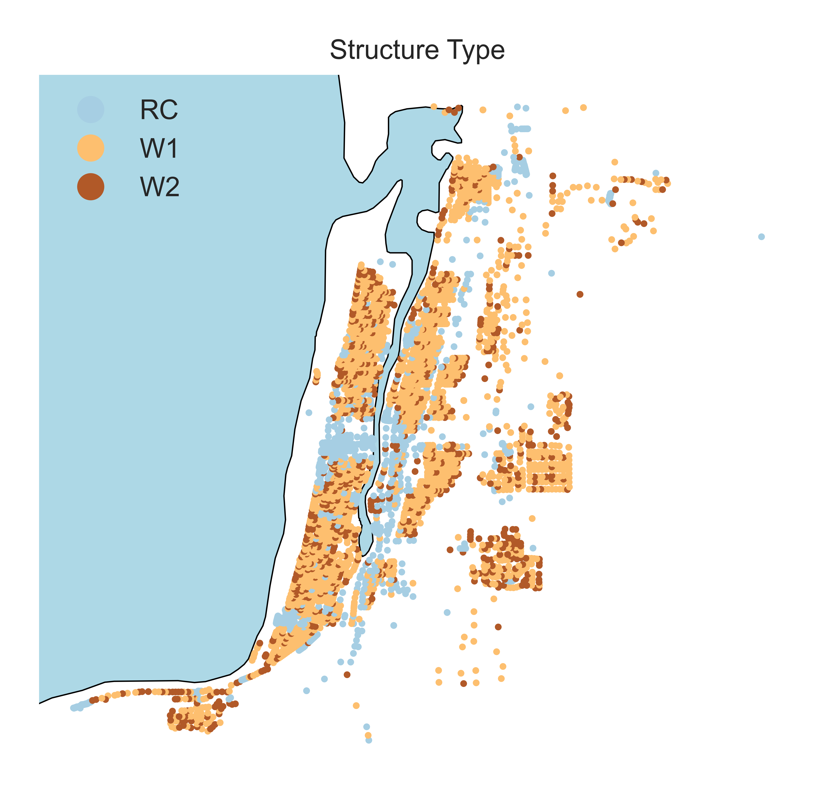
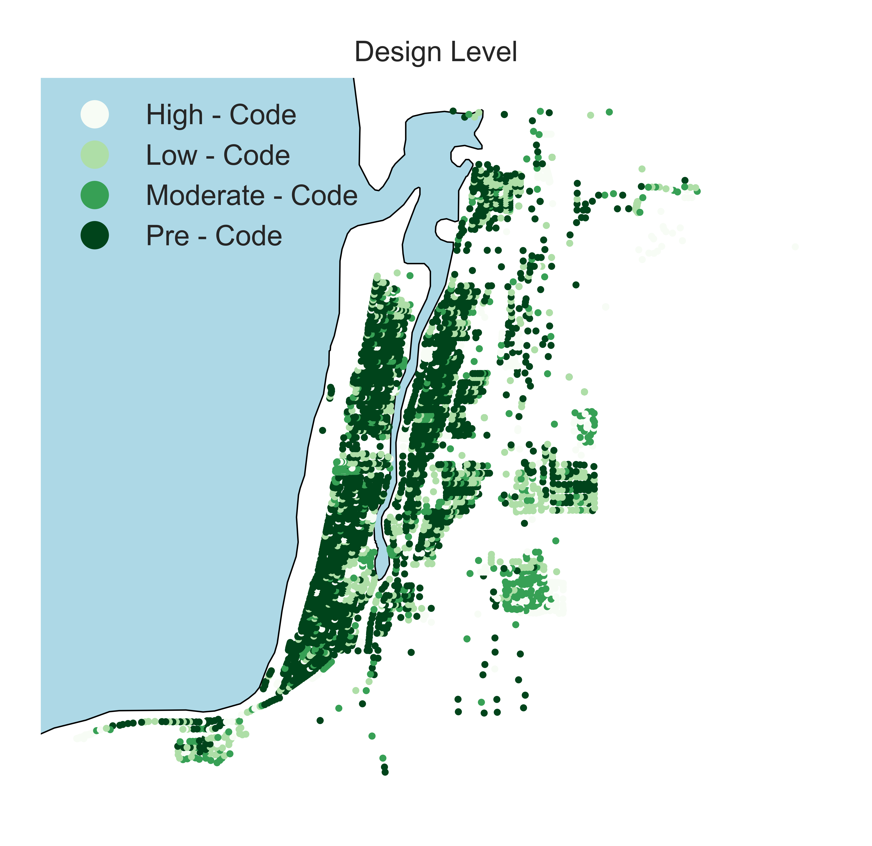
Incentive individual behavior
Retrofit public infrastructure
Planning Tools
Property Buyouts/Land Acquisition
No regulations
Public education initiatives
Land use planning
City zoning regulations
Establish building codes
Relocate public infrastructure
Household Decisions
State & Federal Decisions
Establish building codes
Four building classifications
W1 – wood, light frame
W2 – wood, commercial & industrial
C1L – concrete moment frame, low-rise
C1M – concrete moment frame, mid-rise
Each building classification has four seismic codes:
Pre-, low-, moderate-, high
Current process:
Don’t change building classification
e.g., W1 stays W1
Setup mapping between to-state and seismic code
e.g., if transitioning to residential, must be at minimum low-code
Building codes (BC) for land use transitions
To-state | None | BC1 | BC2
Unoccupied | - | - | -
Residential | - | - | -
Commercial | - | L | -
Seasonal Rental | - | - | H

Slide 14
Incentive individual behavior
Retrofit public infrastructure
Scenario 0:
Status quo
Current zoning
Land use planning in current condition
CSZ at year 40 (1,000-yr)
Public education initiatives
Land use planning
City zoning regulations
Establish building codes
Relocate public infrastructure
Property Buyouts/Land Acquisition
No regulations
Household Decisions
State & Federal Decisions
Incentive individual behavior
Retrofit public infrastructure
Scenario 1:
No regulations = neighborhood effect
No zoning restrictions
Land use planning in current condition
CSZ at year 40 (1,000-yr)
Public education initiatives
Land use planning
City zoning regulations
Establish building codes
Relocate public infrastructure
Property Buyouts/Land Acquisition
No regulations
Household Decisions
State & Federal Decisions
Incentive individual behavior
Retrofit public infrastructure
Public education initiatives
Land use planning
City zoning regulations
Establish building codes
Relocate public infrastructure
Property Buyouts/Land Acquisition
Scenario 2:
Modify zoning layer and enforce zoning regulations
CSZ at year 40 (1,000-yr)
No regulations
Household Decisions
State & Federal Decisions
Incentive individual behavior
Retrofit public infrastructure
Property Buyouts/Land Acquisition
Scenario 3:
Modify zoning layer and enforce zoning regulations
Establish building codes
CSZ at year 40 (1,000-yr)
No regulations
Public education initiatives
Land use planning
City zoning regulations
Establish building codes
Relocate public infrastructure
Household Decisions
State & Federal Decisions
+ building codes

Slide 15
Scenario 0 vs. 2 & 3
Scenario 2 and 3:
Modify zoning layer and enforce zoning regulations
Establish building codes (S3 only)
CSZ at year 40 (1,000-yr)
S0
S2 and S3
Residential-Resort: Provide space for orderly expansion of tourist accommodations and related business such as restaurants and gift shops. Currently single-family units, but are in a state of transition
S3: Building codes (BC) for land use transitions
To-state | BC1
Unoccupied | -
Residential | -
Commercial | -
Seasonal Rental | H

Slide 16
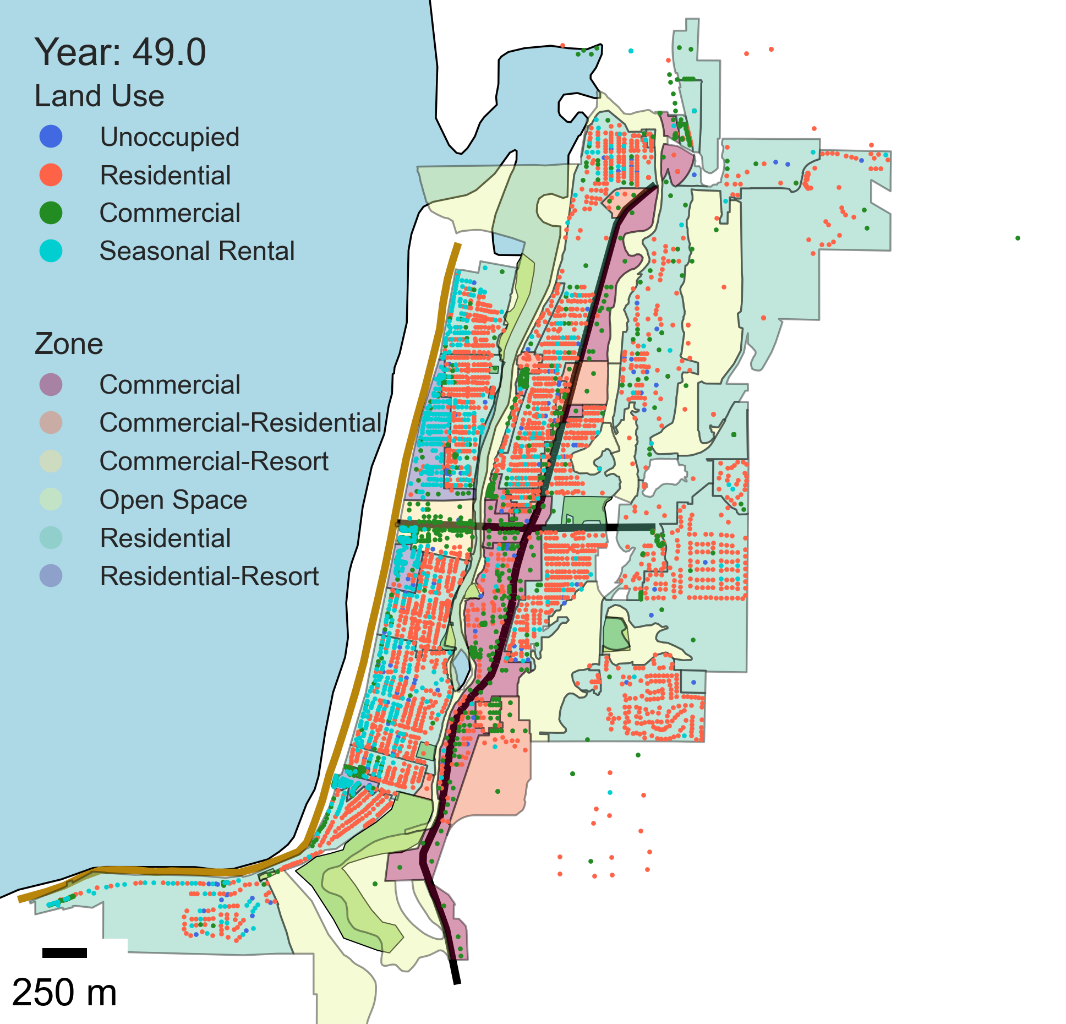
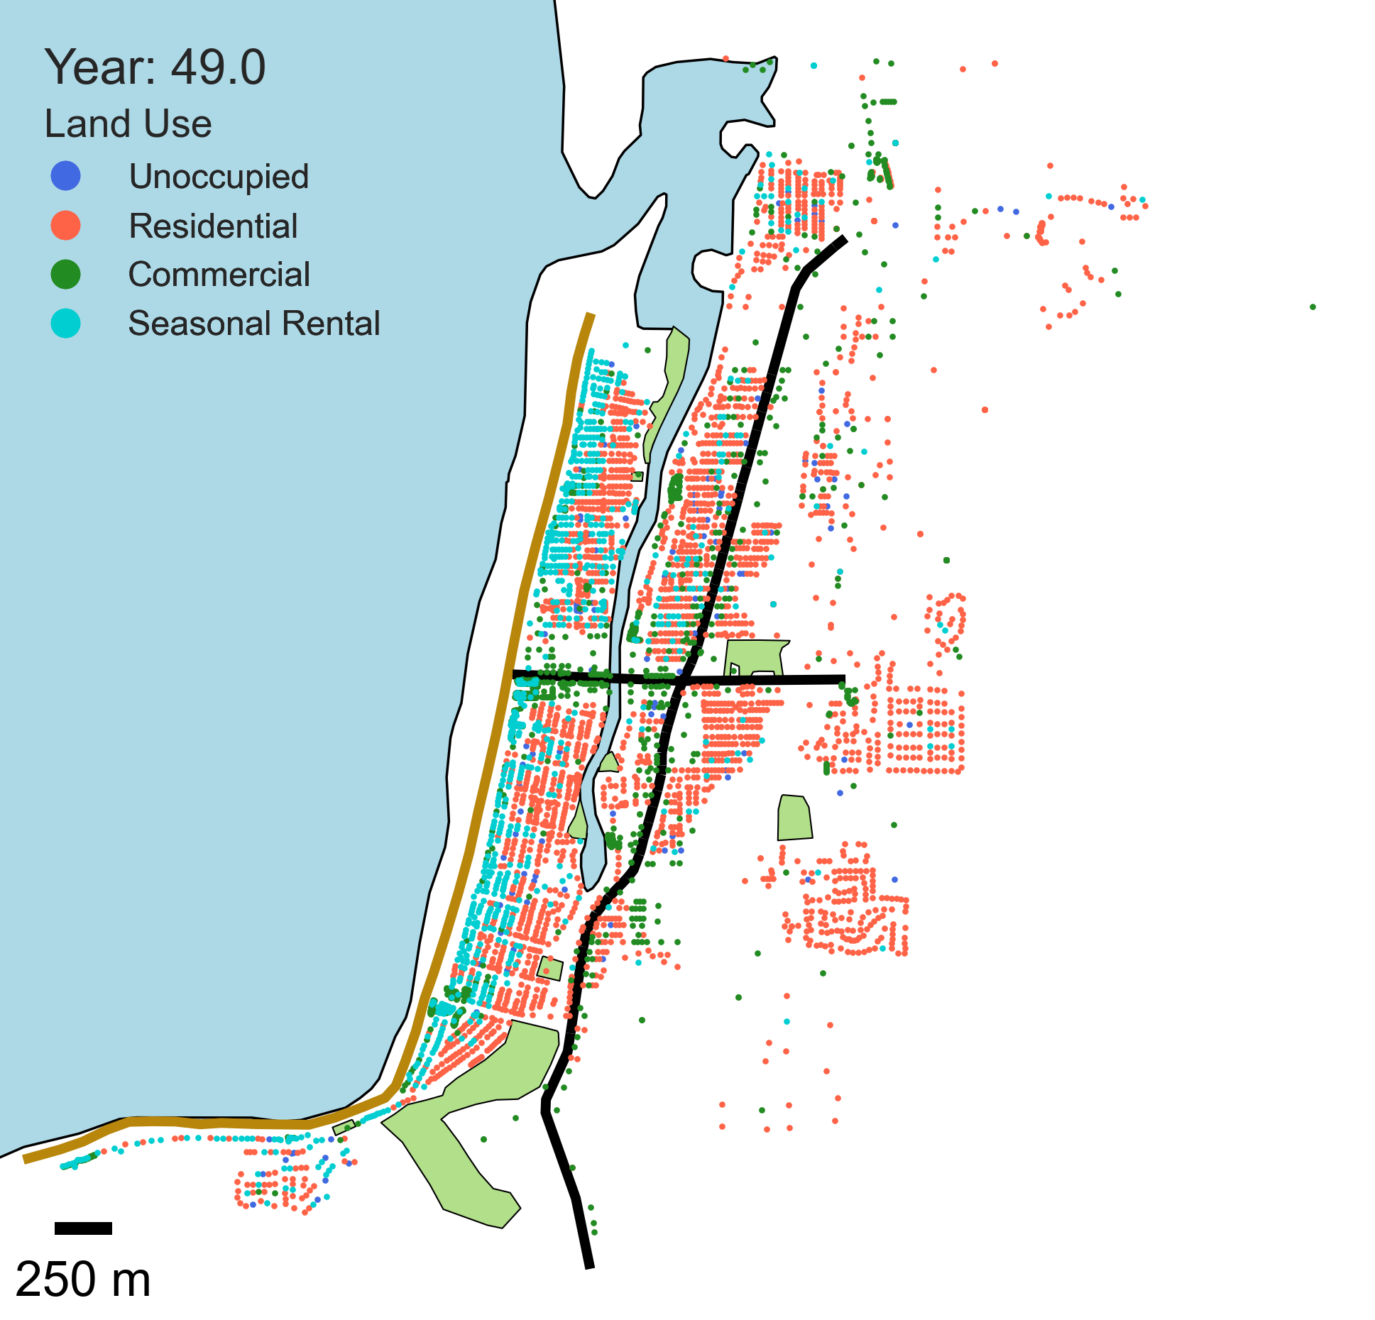

Land use comparisons
Initial land use
Scenario 1:
Unrestricted status quo
No regulations = neighborhood effect
Zoning and land use planning in current condition
CSZ at year 40
Scenario 0:
Status quo
Current zoning
Land use planning in current condition
CSZ at year 40 (1,000-yr)
Scenario 2 and 3:
Modify zoning layer and enforce zoning regulations
Establish building codes (S3 only)
CSZ at year 40 (1,000-yr)

Slide 17
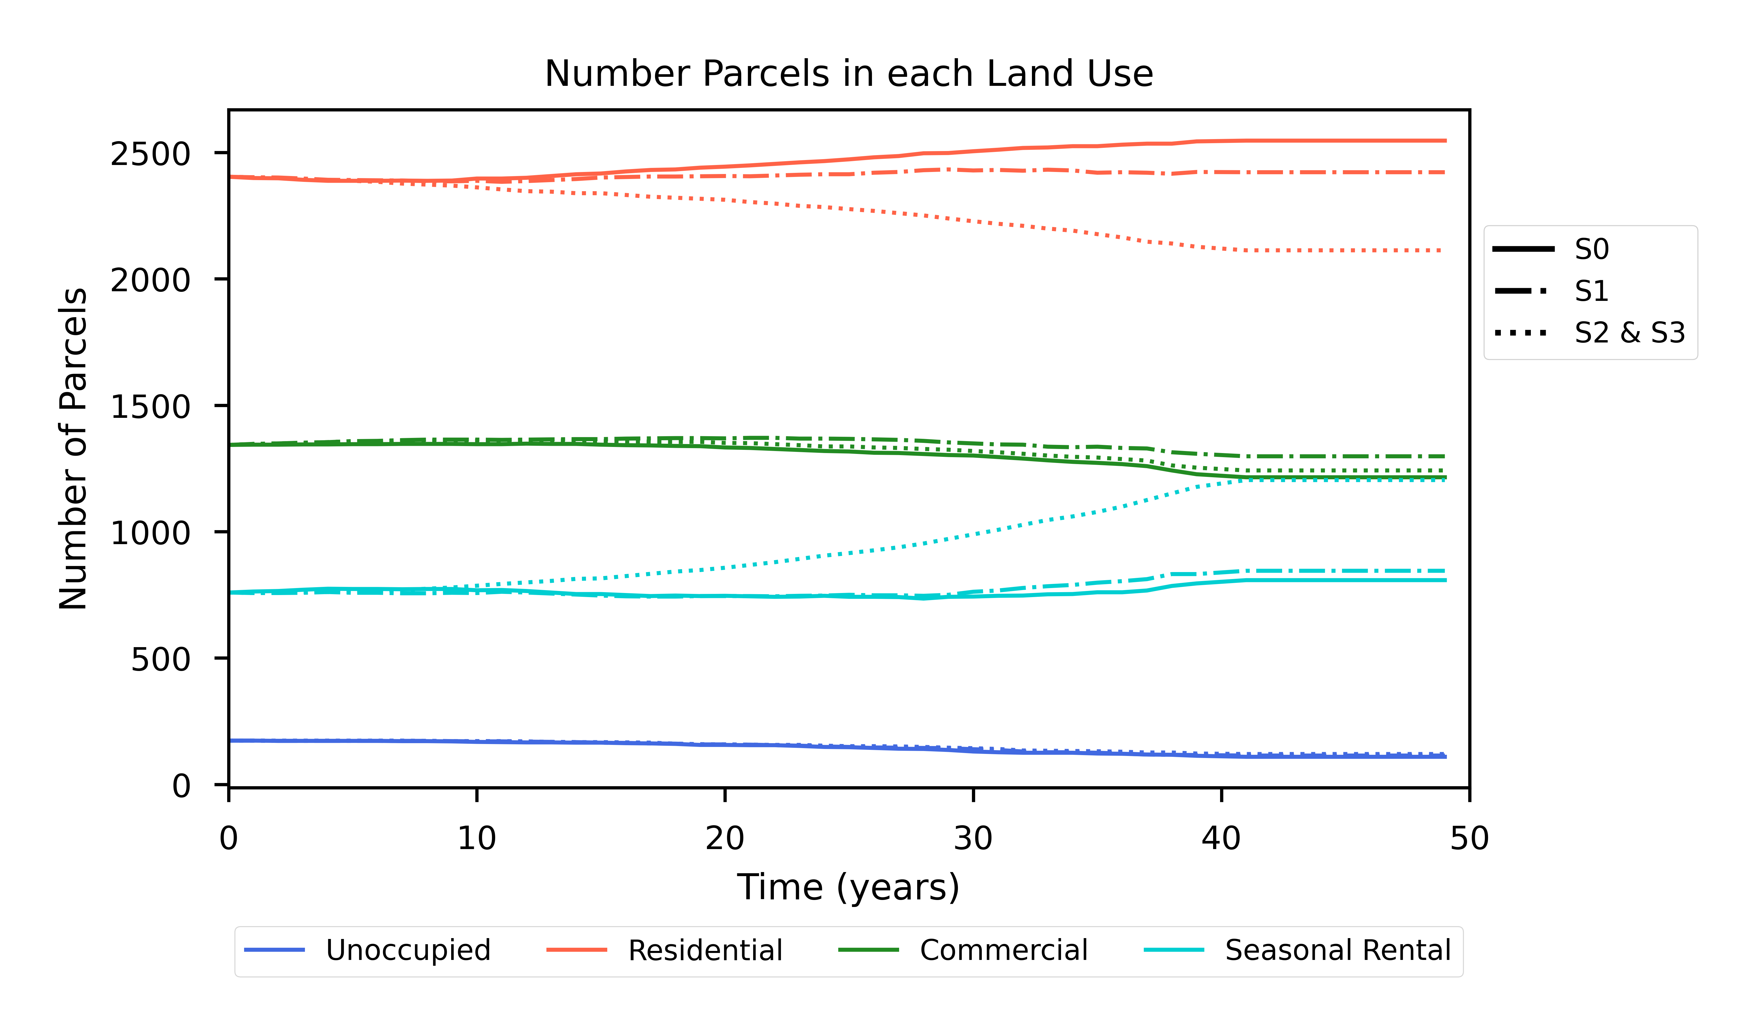
Land use comparisons

Slide 18
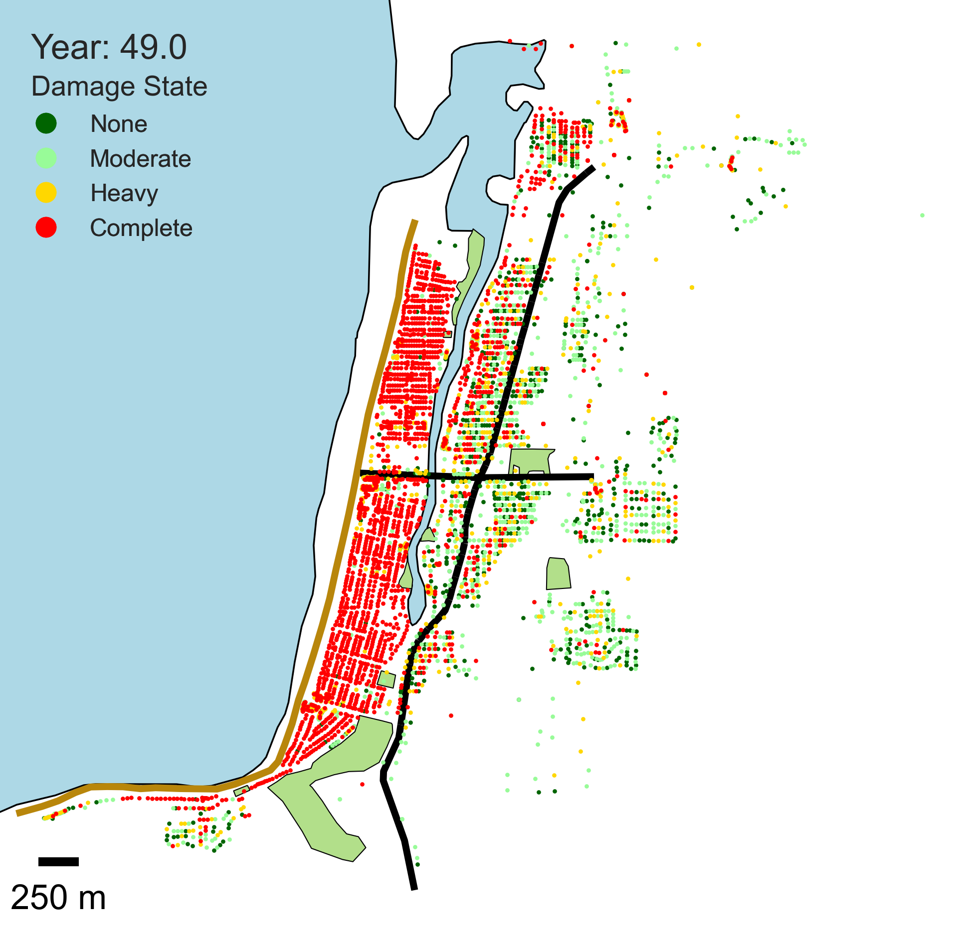
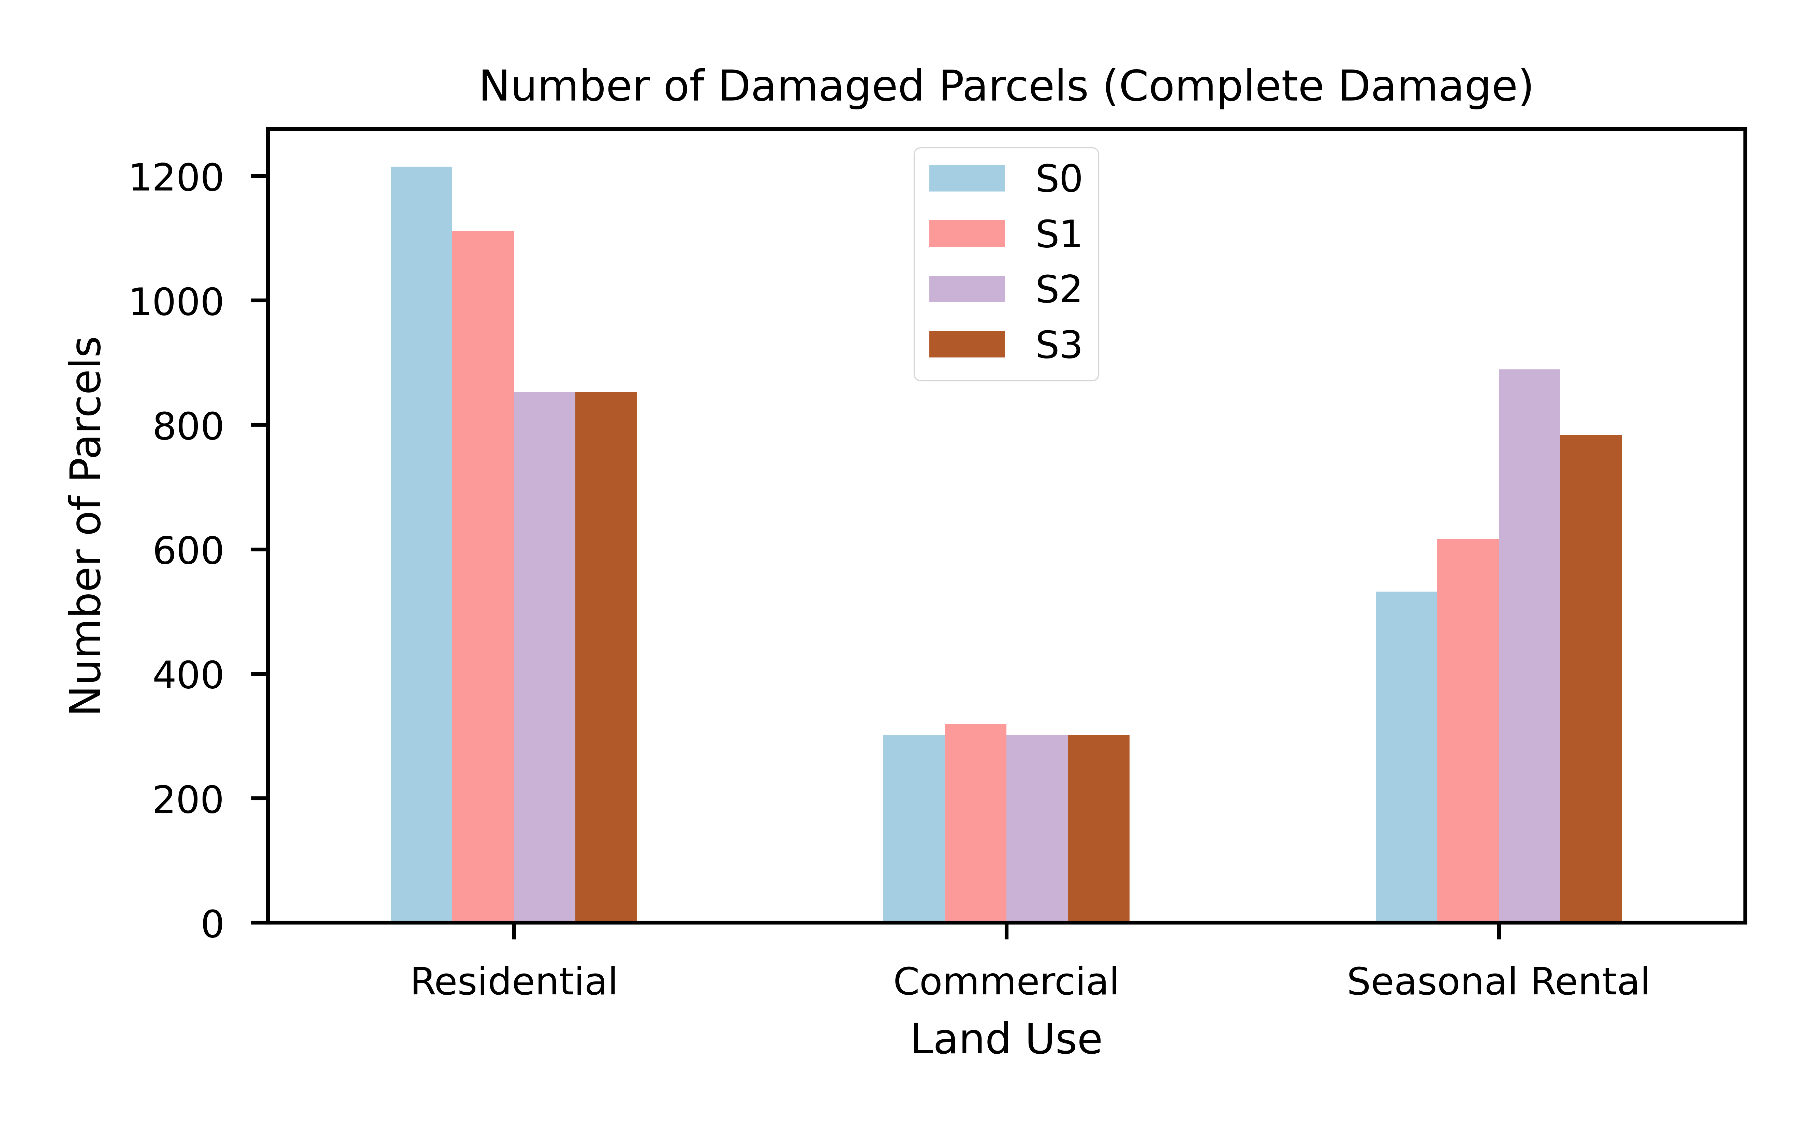
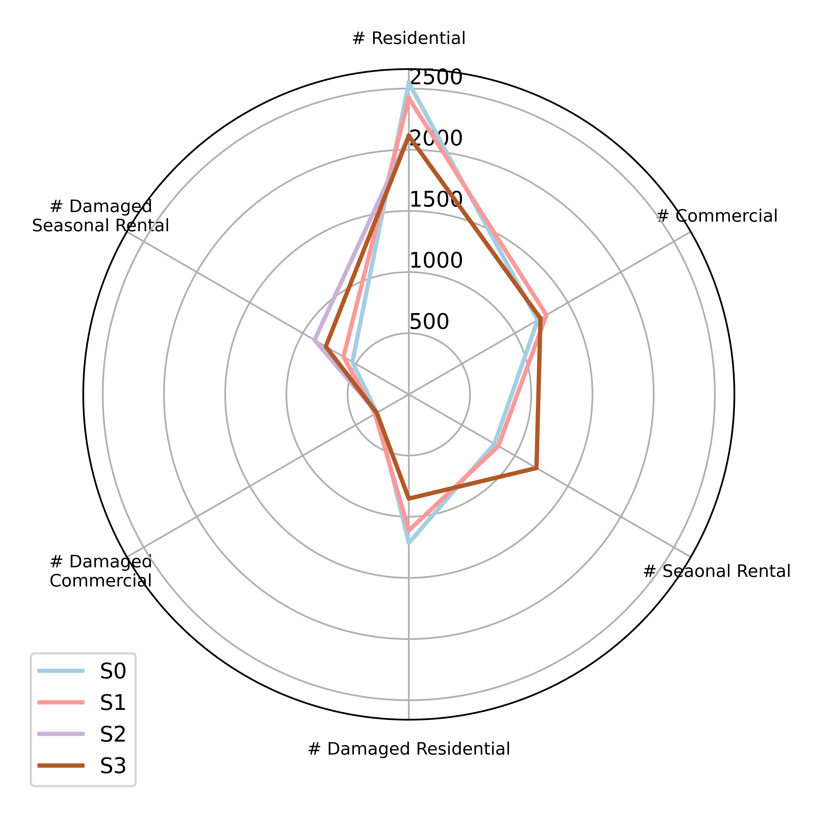
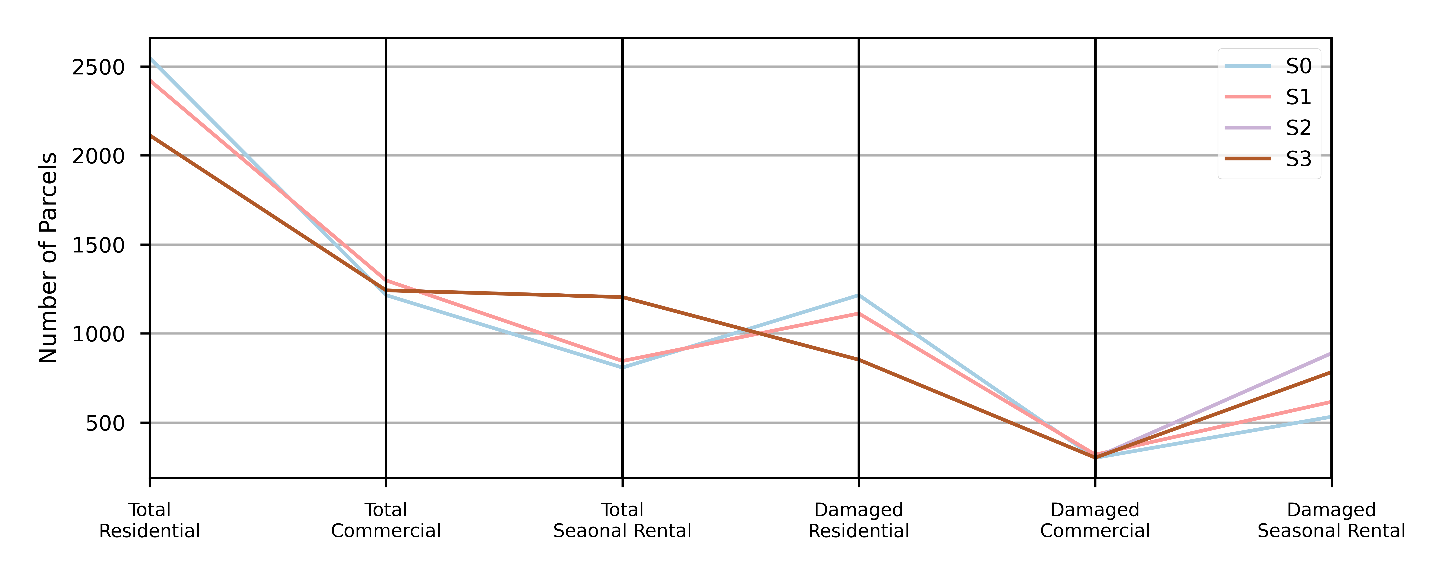
Parcel Damage
Defining “damaged parcel” as being in complete damage state
Still trying to figure out how to best show tradeoffs across policies

Slide 20


Seaside Sub-Testbed
Subset of parcels
516 out of 4,679
Coast to west
Greenspace to south
5 zones

Slide 21
Current Mitigation Toolbox
Retrofit buildings
Retrofit bridges
Retrofit electric poles
Retrofit electric substations
Retrofit water pipes
Retrofit water treatment plants
Retrofit water pumping station
Relocate buildings
Relocate electric substation
Relocate water treatment plant
Relocate water pumping station
Decrease repair times
Raskin and Wang (2017) mitigation strategies
Relocate critical facilities to high ground
Relocate vulnerable populations
Improve and create evacuation options:
Create tsunami vertical evacuation refuges
Complete seismic and tsunami upgrades of bridges
Improve evacuation routes
Prioritize tsunami evacuation education
Improve emergency operations plan (e.g., supply caches and assembly areas)
Create a post-disaster recovery plan
Develop redundant/alternative critical infrastructure
Metrics of Effectiveness
Total economic losses
Benefit-cost ratio
Loss of life
Post-disaster recovery time of community
# of parcels with electricity
# of parcels with transportation access
# of parcels with running water
# of parcels that meet robustness goals
# of parcels that meet rapidity goals
# of parcels that meet resilience goals
Dimensions of Deaggregation
Spatial
Hazard type
Hazard intensity
Infrastructure system
Infrastructure component
Population (resident vs. tourist)
What’s actually feasible or could be implemented in practice?
Don’t want to omnipotently explore what-ifs
e.g., what if we relocate these 30 structures vs. those 30 structures
Urban Planning Tools/Avenues of Implementation
Retrofit public infrastructure
Relocate public infrastructure
City zoning regulations (e.g., commercial vs. residential-commercial areas)
Land use planning (e.g., location of greenspaces)
Establish building codes
Incentivize individual behavior (e.g., via taxes)
Public education initiatives
Property buyouts/Land acquisition
What’s challenging about coastal communities?
Tourist-driven economies
Proximity to hazard
Large population fluctuations (winter -> summer, week -> weekend)
“Balancing tsunami-risk with need to be in tsunami inundation zone” (Raskin and Wang, 2017)
Balancing resources invested in tourist safety vs resident well-being
Multiple hazards
Scale of hazards
Hurricanes, tsunamis larger than other hazards (e.g., tornados)
For NW - Occurrence of CSZ
Low probability of occurrence

Slide 22
Research Question
General:
What is the impact of different urban planning measures on community resilience against natural hazards?
How does temporal component of implementing policy impact resilience?
More specific:
What’s more effective for increasing community resilience: land use planning, zoning, or building regulations?
Top-down vs. bottom-up for resilience planning
What has more impact on ___ (metric): ___ or ___ (planning tools)
How to bring in unique/challenging parts of Seaside?
Tourist vs. resident
Deaggregate by tourist and residential populations
Policy geared toward one population vs. the other?
Multiple hazards
How to prioritize resources (benefit-cost ratios?)
Occurrence of CSZ
Time-sensitive model
Simulations with CSZ occurring at year 0, 25, 40, etc.
Metrics of Effectiveness
Total economic losses
Benefit-cost ratio
Loss of life
Post-disaster recovery time of community
# of parcels with electricity
# of parcels with transportation access
# of parcels with running water
# of parcels that meet robustness goals
# of parcels that meet rapidity goals
# of parcels that meet resilience goals
Urban Planning Tools/Avenues of Implementation
Retrofit public infrastructure
Relocate public infrastructure
City zoning regulations (e.g., residential-commercial vs. resort-commercial)
Land use planning (e.g., location of greenspaces)
Establish building codes
Incentivize individual behavior (e.g., tax breaks)
Public education initiatives
Property buyouts/Land Acquisition
What’s challenging about coastal communities?
Tourist-driven economies
Multiple hazards
Scale of hazard s
Occurrence of CSZ (For NW)
Incentive individual behavior
Retrofit public infrastructure
Public education initiatives
Land use planning
City zoning regulations
Establish building codes
Relocate public infrastructure
Property Buyouts/Land Acquisition
No regulations
Household Decisions
AHJ
(Authority Having Jurisdiction)
State & Federal Decisions

